Slide 1

CAMBRIDGE SCHOOL, INDIRAPURAM
Computer Science
Project

Slide 2

ACKNOWLEDGEMENT
I would like to thank the CBSE board, our Principal, Ms. Hardeep Kaur and our Computer Science Teacher, Ms. Vandana Mittal, who gave not just me, but all the others students the opportunity to make such a beautiful project which can be used for public welfare. I promise to make utmost use of this opportunity.

Slide 3


Welcome to the amazing world of
MySQL & Python!

Slide 4

PREFACE
The aim of the project is to establish a tangible connection between the two interfaces - MySQL and Python, so as to solve a real life word problem worthwhile to solve.
My project aims to solve the basic queries which tend to arise at any billing counter of a confectionery store.
Operations like displaying the pre-existing customer data, editing their phone numbers, displaying the current sales in both statistical and graphical formats, etc. have been met.

Slide 5


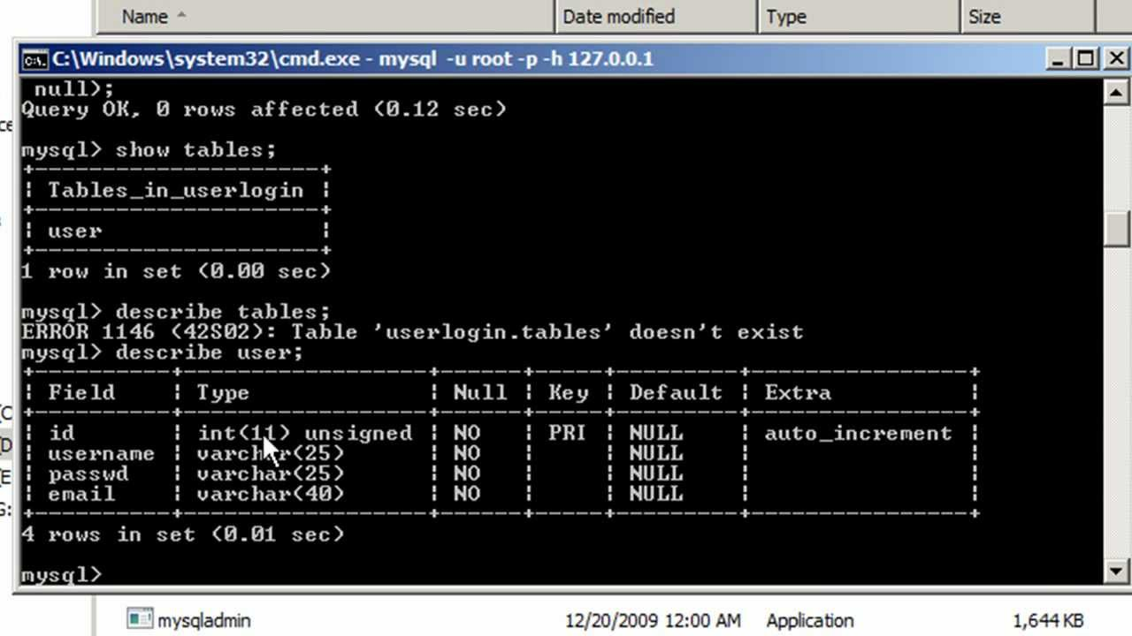
Some snaps of the entire program

Slide 6

DATABASES & TABLES

Slide 7
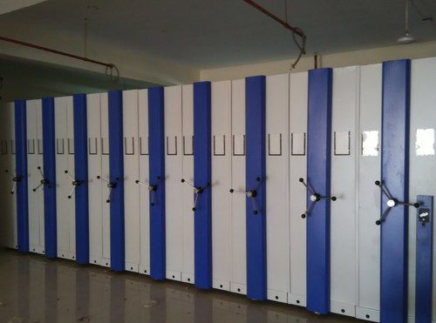
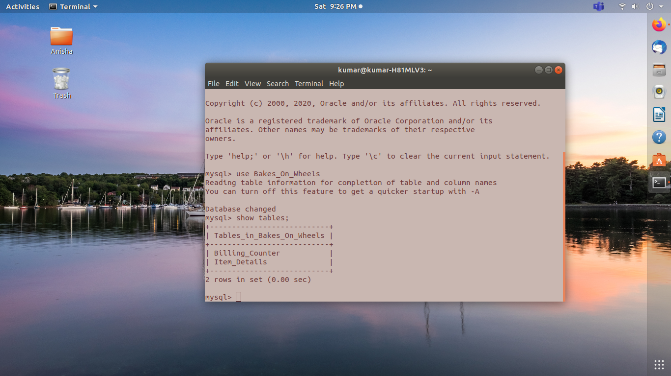
Database name: Bakes_On_Wheels
Tables existing:
Billing_Counter :– consists of invoice number, customer’s contact details, quantity of items purchased, net amount, etc.
Item_Details :– consists of items on the menu and their cost per unit
DATABASE :–
Bakes_On_Wheels

Slide 8

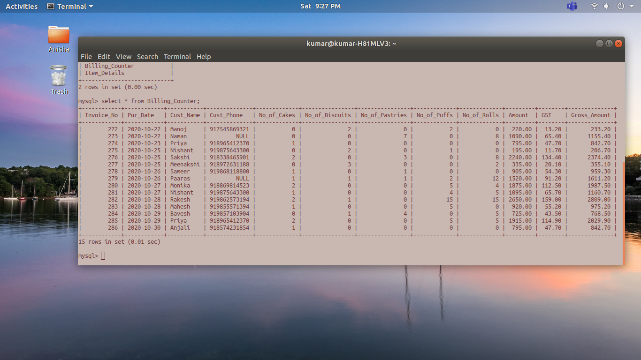
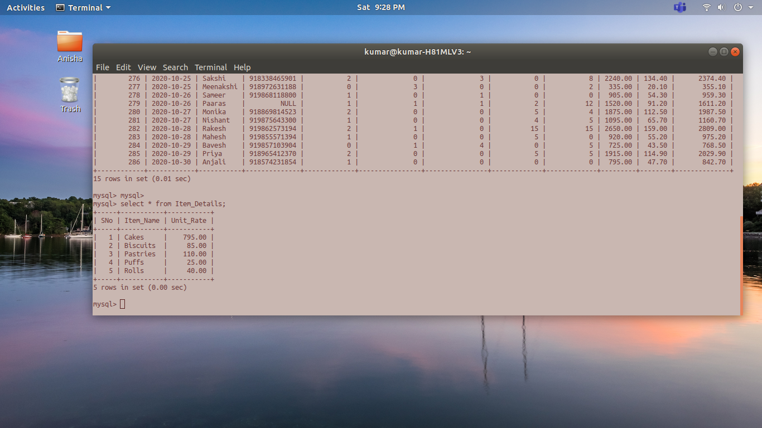
Tables:
Billing_Counter
Item_Details

Slide 9

PYTHON PROGRAM

Slide 10

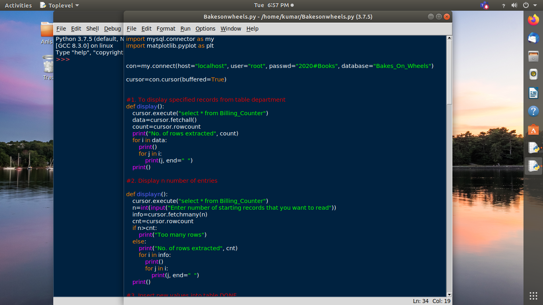
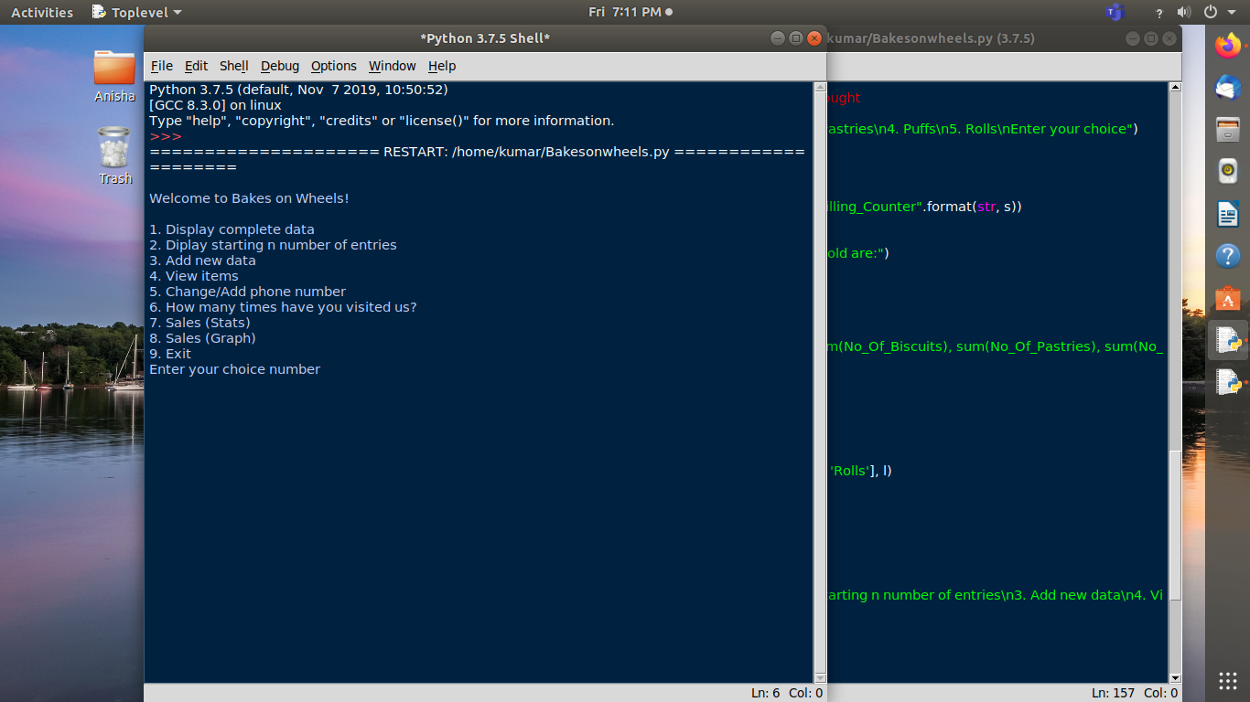
PROGRAM CODE
#Code 1 and 2
OUTPUT SCREEN

Slide 11

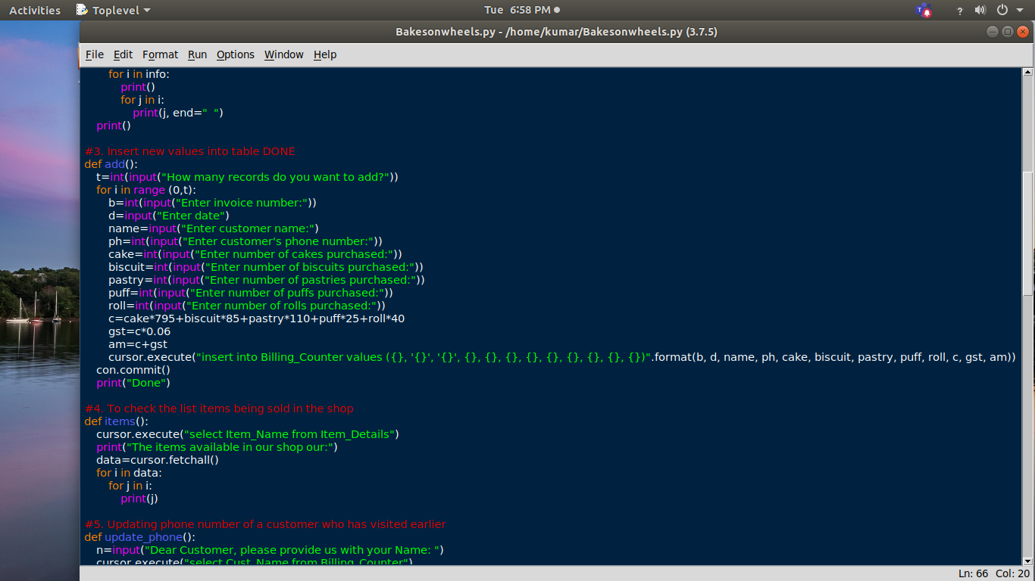
PROGRAM CODE
#Code 3

Slide 12

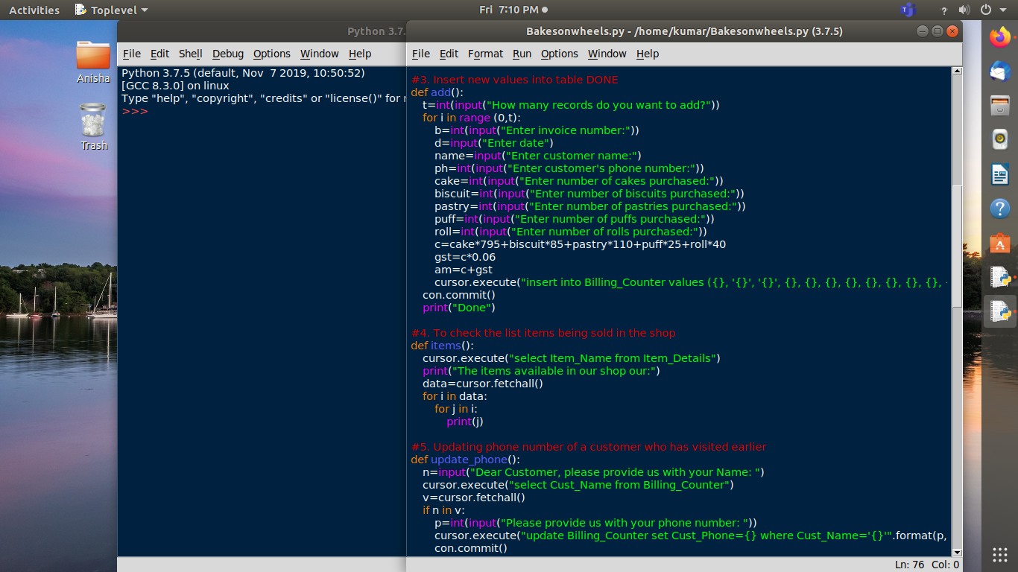
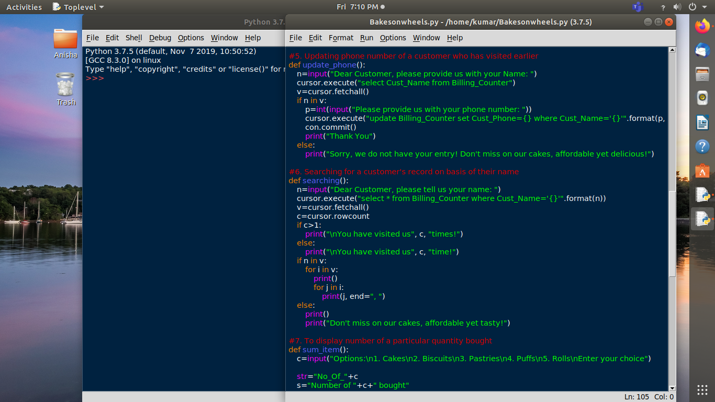
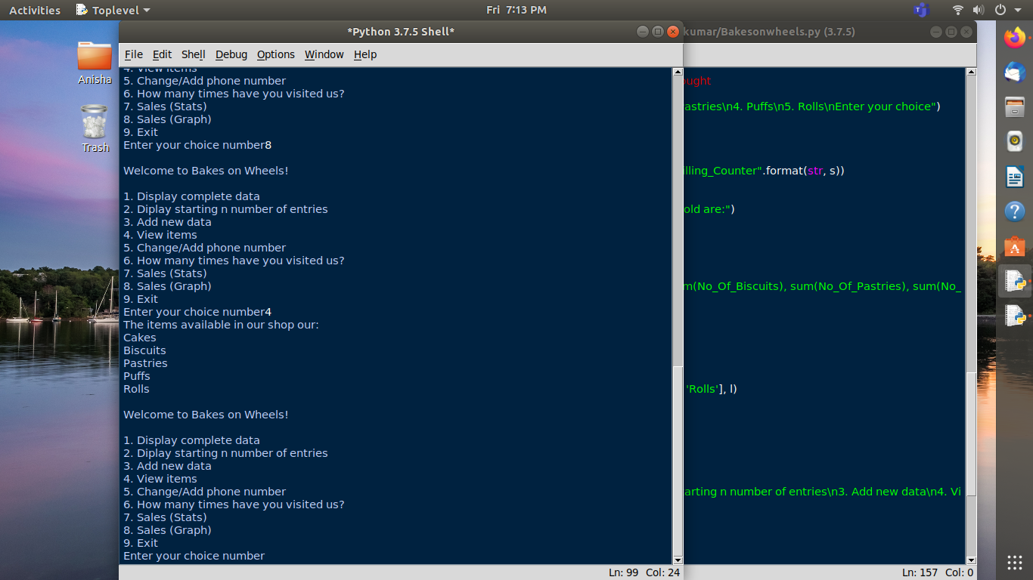
PROGRAM CODE
#Code 4
PROGRAM CODE
#Code 6
OUTPUT SCREEN FOR
#Code 4

Slide 13
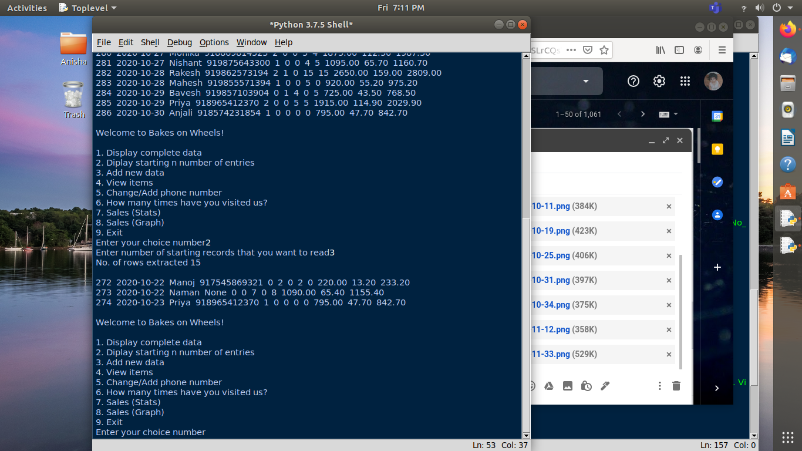
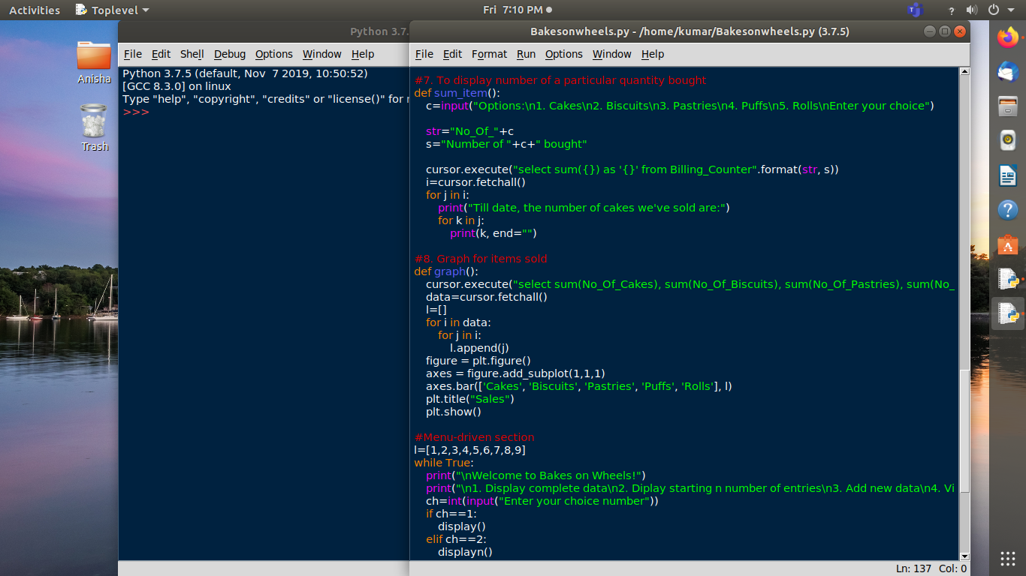
OUTPUT SCREEN FOR
#Code 2
PROGRAM CODE
#Code 7

Slide 14
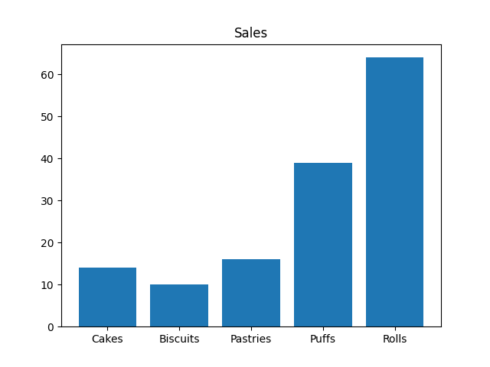
GRAPH FOR PROGRAM
Code #8

Slide 15

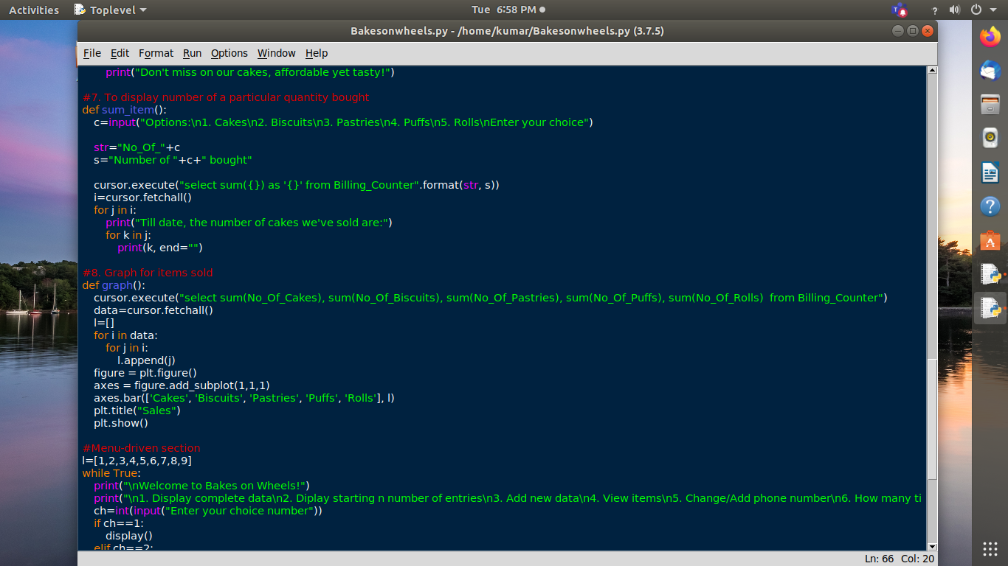
PROGRAM CODE
#Code 8

Slide 16

This was a very concise view of the code snippets, how the entire program would run, basic output screens, etc. of the entire project.
The entire project was build up not only to offer a help for the confectionery shop-owners/keepers but also for all the other shop owners who have helped us a lot through our entire lives. This project is dedicated to all of them.

Slide 17

THANK YOU SO MUCH
Name: Anisha Kumar
Class: XII-A
Roll No: 2

